Slide 1

Panel of Pioneers:
Perspective and
Predictions
Speakers:
V. Taaffe, J. Maltais, G. Rovegno, R. Ward
Notes:
>>ADJUST MICROPHONE<<
Good morning everyone. Thank you for attending this panel session.
In presenting this session for you, it is an honor, a privilege, and a pleasure, to work with George Rovegno and Drs. Maltais and Ward. All are well-regarded colleagues and long time friends.
In this session, a panel approach will be used to convey our perspective and predictions on some of the more significant technical aspects of dialysis.
Objectives for the overall panel session are:
To explore the increasing importance of biomed techs in a changing dialysis world.
To examine equipment disinfection, in regard to rhetoric, reality and the future,
To identify the current and future significance of electronic medical records in dialysis, and
4) To determine whether or not carbon is the only answer as an element of water pre-treatment.
Let’s get started by taking a look at the increasing importance of biomed techs in a changing dialysis world. >>NEXT<<

Slide 2
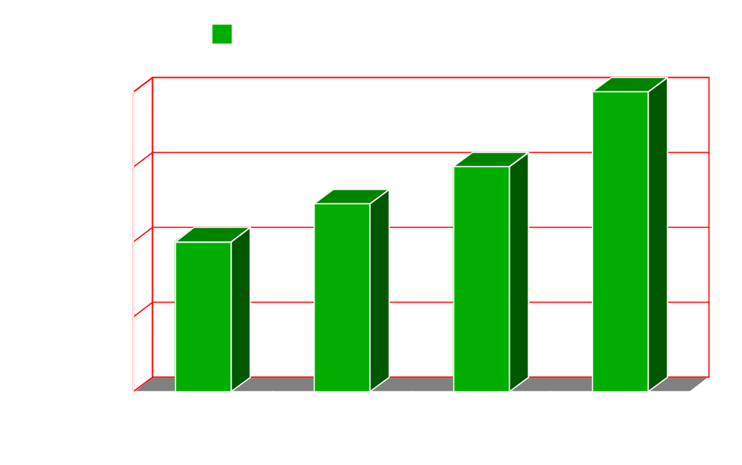
Increasing Importance of
Biomed Techs
In a Changing Dialysis World
V. Taaffe – © 2009
Notes:
Because this segment of the panel session is somewhat subjective, and I am used to presenting on specific and defined technical issues, it made sense to ask for input from multiple individuals each having 25 or more years of dialysis biomed experience.
>>NEXT<<
Copyright RPC - Vern Taaffe, 2010

Slide 3

Input from the Experts
Thank you to all who contributed comments:
Danny Concepcion – St. Joe’s., Orange, CA.
Mark Rolston – FMCNA
Chuck Weddle – IDF
Bruce Fife - USRC
John Dahlin – FMCNA
Doyle Siglin – FMCNA
Nick Grimley - RPC
Mike Lorenson – RPC
Dan Forde - RPC
Multiple people (12) – RenalWEB
Notes:
Comments from the persons listed on this slide were very helpful toward providing the broadest possible perspective relevant to the increasing importance of dialysis biomed techs.
>>NEXT<<

Slide 4
Perspective on the Past
One biomed for 1 or 2 clinics (common)
  - Limited travel
Responsibilities of biomed technicians
  Repair/maintain non-complex equipment
  Inventory control (informal) for 1 or 2 clinics
  Procedure management in relation to regulatory
  requirements of the time (for 1 or 2 clinics)
  Manage dialyzer reuse program (where applicable)
  - In-service training & misc. support for staff
Training of biomed technicians
  Education budget allowed outside training on a routine
  basis (e.g. equipment, professional development, etc.)
Notes:
>>NEXT<<
A generation ago, it was typical and routine to have one biomed tech service 1 or 2 clinics. Limited travel was the standard. Many hospital based dialysis clinics existed at the time. Some hospital biomed techs serviced other medical departments in addition to dialysis. >>NEXT<<
Responsibilities of biomed technicians included, but were not limited to:
Repair & maintenance of equipment having uncomplicated hydraulic & electronic components.
Inventory control for 1 or 2 clinics…and informal management of the parts stock was common.
Procedure management in relation to regulatory requirements of the time
Management or supervision of a 1 or 2 clinic dialyzer reuse program (where applicable), and
In-service training & miscellaneous support for staff in 1 or 2 clinics
>>NEXT<<
In regard to training of biomed technicians:
On a routine basis, education budgets of the time typically allowed outside training on equipment, professional development, and other educational areas.
From the past to the present, several factors have had an impact on the biomed position.
The key factors are outlined on the next four slides. >>NEXT<<

Slide 5

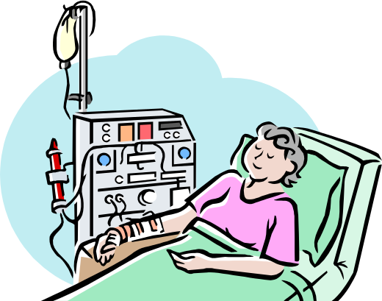

Sluggish Reimbursement Rate
CMS
1980 1990 2000 2010
Year
Notes:
In real dollars, the outpatient dialysis reimbursement rate has fallen over time. >>NEXT<<
Steadily increasing costs to Medicare for the ESRD program have resulted in attempts at cost containment by the Centers for Medicare and Medicaid Services through lack of adjustment for inflation in payments for dialysis care. This has resulted in diminished reimbursement in actual dollars when adjusted for inflation.
Dialysis providers have tried various tactics to remain financially solvent. Some of these
tactics include: obtaining lower equipment and supply costs from competition in the product marketplace; dialyzer reuse; achieving unit operational efficiencies; and changing staff size. Increased revenues from injectable medications that are administered at the time of dialysis have also helped.
>>NEXT<<

Slide 6


Consolidation
RCG Acquires NNA
DaVita Acquires Gambro
FMC Acquires RCG
RAI Acquires NRA
Notes:
Predictably, the sluggish reimbursement rate has contributed to rapid consolidation in the dialysis industry. >>NEXT<<
In the past decade, the landscape of the dialysis industry has rapidly evolved as a result of the explosive growth and consolidation in the for-profit sector. In addition, there has been a corresponding contraction of market share for independent units.
Potent business and financial advantages that accrue as a result of consolidation in a market-based system include: volume-based cost efficiencies, technical efficiencies, improved information and tracking systems, access to affordable capital, vertical integration of service and product, the ability to offer attractive one-partner solutions to payers…and other significant benefits. Consolidation allows dialysis providers to maintain profit margins in the face of declining constant dollar reimbursement. >>NEXT<<
According to the Medicare Payment Advisory Commission, in 2007, the Medicare profit margin for all dialysis facilities was 4.9 percent. However, the disparity between the two largest treatment providers and everyone else is significant. The two largest providers had a margin of 6.9 percent, while other freestanding providers had a margin of just 0.2 percent. This difference in margins clearly illustrates the economic benefit of consolidation >>NEXT<<

Slide 7




Regulation
Notes:
Over the years, the amount and complexity of regulation for dialysis providers has increased dramatically. The latest CMS Conditions for Coverage are much more demanding in that they contain many more tag items when compared with prior CMS requirements. Many of these tag items influence, how, when, and by whom, maintenance, repair and testing will be performed and documented.
In addition, by reference, the Conditions for Coverage now require compliance with certain CDC and FDA provisions… such as CDC infection control guidelines and the use of devices that are FDA 510k cleared.
All of this has made our biomed tech, shown on the slide >>NEXT<<, a little dizzy trying to keep up with the regulatory requirements and subsequent procedural changes.
>>NEXT<<

Slide 8
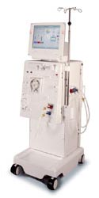
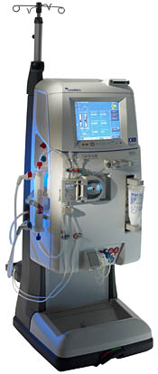
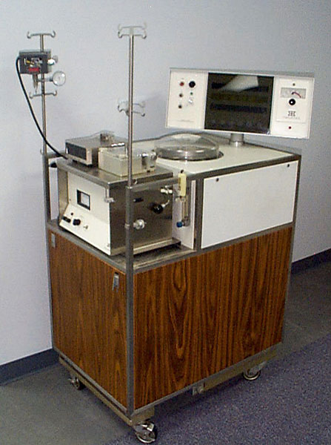
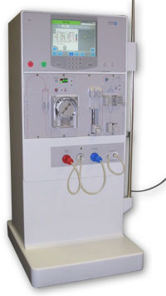
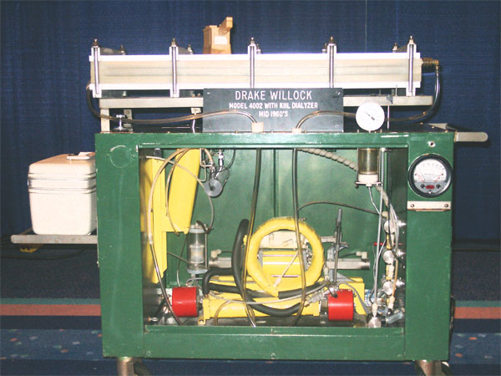
Equipment Evolution
Drake-Willock 4002
Travenol
RSP
Fresenius
2008K
B. Braun
Dialog
Gambro
Phoenix
Notes:
The last, but certainly not the least significant, key factor considered here…is equipment evolution.
>>NEXT<< Early dialysis equipment included dialysis machines like the Drake-Willock 4002 and the Travenol RSP. Central dialysate delivery systems and uncomplicated DI water systems were also popular. Repair and maintenance of these type of machines mainly involved work on straightforward hydraulic systems and making calibrations on electronic circuit boards having trim pots for adjustments.
>>NEXT<< The dialysis equipment of today includes dialysis machines like the Fresenius 2008K, the Braun Dialog, and the Gambro Phoenix. In addition, water systems are now almost exclusively RO based. Repair and maintenance of all these sophisticated machines involves work with complex hydraulic systems that are controlled by computerized electronics operated by and adjusted through the use of software.
>>NEXT<<

Slide 9
Perspective on the Present
One biomed for multiple clinics (common)
  - Considerable travel
Responsibilities of biomed technicians
  Repair/maintain complex equipment (software driven)
  Inventory control (formal) for multiple clinics
  Procedure management in relation to greatly
  increased regulatory requirements
  Manage dialyzer reuse programs (where applicable)
  - Provide multiple clinics w/ training & misc. support
Training of biomed technicians
  Education budget emphasizes receipt of training from
  within the dialysis provider organization
Notes:
OK. Let’s take a look at the present situation. >>NEXT<<
In the dialysis world of today, it is typical and routine to have one biomed tech service multiple clinics. Considerable travel has become the standard and there are now far fewer hospital based dialysis clinics. >>NEXT<<
Responsibilities of biomed technicians now include, but are not limited to:
Repair & maintenance of complex equipment, much of which is software driven.
Inventory control for multiple clinics…and formal management of the parts stock is now common.
Procedure management in relation to greatly increased regulatory requirements.
Management or supervision of dialyzer reuse programs in multiple clinics (where applicable), and
Providing in-service training & miscellaneous support for staff in multiple clinics
>>NEXT<<
In regard to training of biomed technicians:
Many, perhaps most education budgets now emphasize receiving training from within the dialysis provider organization. >>NEXT<<

Slide 10
Do You Agree?
Sluggish reimbursement rate
Consolidation
Increased regulation
Equipment evolution
… have all contributed to a critical need for Biomed Techs to take on a greater number of tasks and increased responsibility.
Notes:
Considering this assessment of the present compared with the past, do you agree >>NEXT<< that a sluggish reimbursement rate,
>>NEXT<< consolidation,
>>NEXT<<, increased regulation,
>>NEXT<< and equipment evolution,
>>NEXT<< have all contributed to a critical need for biomed technicians to take on a greater number of tasks and increased responsibility?
>>NEXT<<

Slide 11
Predictions for the Future
Increased visibility
Greater recognition
Higher compensation rate for biomeds
that have expanded responsibilities and
certification.
Notes:
Now that we have reflected on the past and present. What about the future for dialysis biomed technicians?
In December of 2009, the US Department of Labor published the 2010-2011 edition of their Occupational Outlook Handbook. This handbook offers salary projections, employment projections, and general information on numerous careers. For the first time, biomed techs have been placed in their own category as medical equipment repairers. Previously, medical equipment repair was grouped in the same category with other repair professions such as watch, camera, and musical instrument repair. Because it will increase visibility for the profession and it demonstrates that government leaders are now acknowledging the importance of biomed technicians, this change is of great significance for all biomed technicians.
Patient safety will be increasingly tied to quality assurance associated with: complex regulatory compliance, proper maintenance of sophisticated equipment including water systems, and effective control of micro-organisms. Payment from CMS, and clinic certification, cannot continue without passing ESRD audits in these important biomed areas.
As this understanding prevails, there will be greater recognition for dialysis biomed technicians and a higher compensation rate for biomeds that have expanded responsibilities and certification. >>NEXT<<

Slide 12

Training!
Make it a Bright Future
With:
Confidence & positive attitude
Certification
Continuing education
… the critical need for Biomed Techs can be converted to an opportunity for advancement and career growth, for those that can adapt.
Notes:
To close this part of the panel session, the points made here make it clear that
>>NEXT<< with confidence and a positive attitude,
>>NEXT<< certification,
>>NEXT<< and continuing education that includes improvement of communication skills and learning about capital equipment planning,
>>NEXT<< the critical need for dialysis Biomed Techs can be converted into an opportunity for advancement and rewarding career growth for those that can adapt. >>PAUSE<<
In regard to certification, the NNCO Certified Biomedical Nephrology Technician exam is being updated at this meeting and the updated exam should be available in the near future.
Check with Mark Rolston for more details. >>PAUSE<<
In the interest of continuing education, let’s move into the next segments of the panel session in which Dr. Maltais, George Rovegno, and Dr. Ward will present respectively on equipment disinfection, electronic medical records, and “Is Carbon the Only Answer”.
Thank you very much for your kind attention and now please welcome Dr. Jo-Ann Maltais. >>NEXT<<

Slide 13
Panel of Pioneers:
Perspective and
Predictions
Speakers:
V. Taaffe, J. Maltais, G. Rovegno, R. Ward
Notes:
>>SPEAKER INTERVAL SLIDE<<
>>NEXT<<

Slide 14
Panel of Pioneers:
Perspective and Predictions
Infection Control & Equipment Disinfection Rhetoric, Reality & Future
Jo-Ann B. Maltais, Ph.D.
NANT 27th Annual National Symposium
Las Vegas, NV
March 3, 2010

Slide 15
Infection Control
Infection Control is the Responsibility of Everyone Involved in the Dialysis Treatment Process

Slide 16
Chronic Hemodialysis Patients at
High Risk for Infection
Long-term vascular access; need for routine access to bloodstream for therapy delivery
Immunosupressed state
Concurrent treatment along with other patients
Frequent hospitalization and surgery
Exposure to infectious agents—bacteria & viruses
  Person to person transmission
  Contaminated devices, equipment, supplies
  Environmental surfaces
  Hands of personnel
  Nosocomial infections in hospital & clinic environments
Extended courses of antibiotic treatment

Slide 17
Infection Control--Rhetoric
Too many patients
Too many regulations
Too much paperwork
Too little time
Too few resources
Need to focus on patient treatment
No time for training
We do the best we can!

Slide 18
Infection control--Reality
Number of dialysis patients continues to rise
  309,269 patients were treated for ESRD in U.S. in 2004
  Twice the number treated in 1994
Infection is the 2nd most common cause of death
  Accounts for 14% of mortality
The number of new and resistant bacteria and viruses continue to rise (MRSA, VRE, H1N1)
Clinics cited for Infection Control Non-Compliance
  58 clinics under TAG 110

Slide 19
Infection control--Reality
Clinic resources continue to decline; training budgets reduced
Compliance with vaccination, monitoring and hygiene requirements is inconsistent
Immunosuppressed patients require higher vaccine doses, multiple dosing, frequent monitoring and limited exposure to infectious agents
More time, More resources, More expense

Slide 20
Infection Control--Future
More Training Will Be Needed To:
  Increase awareness of infectious agent sources & how transmitted
  Focus on steps each person can take in their position to reduce the risk of transmission of infectious agents to patients
    BioMed Techs
      Water treatment systems—maintenance and control
      Concentrate preparation and delivery--risks & responses
      Hemodialysis system maintenance & disinfection
      Monitoring and trending—respond to early warnings
      Validation of control systems and frequency of disinfection
      Periodic audits for regulatory compliance

Slide 21
Infection Control--Future
Better products and processes to make compliance with regulation & infection control practices more efficient will be forthcoming
  Electronic patient records
  More stringent bacterial & endotoxin limits
  Improved system designs for bacterial, endotoxin & biofilm control and removal (e.g. ozone disinfection, heat disinfection)
  Validation of systems & processes by manufacturers
  Verification and control by BioMed Techs
Work smarter, not harder!

Slide 22
BioMed Techs Make a Difference
  Water Treatment System
  Concentrates & Dialysate
  Dialysis Machines
  Dialyzer Reuse
Notes:
Essential to protect quality of treatment and safety of the patient

Slide 23
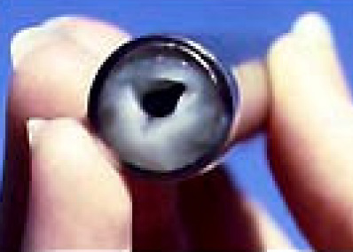
Disinfection Water Treatment System
What Matters
Design of System
Disinfectant Used
Concentration
Dwell Time
Residuals
Frequency
Ryder, M. Medical Biofilm Research
TargetBSI.com Webinar 7/28/09

Slide 24
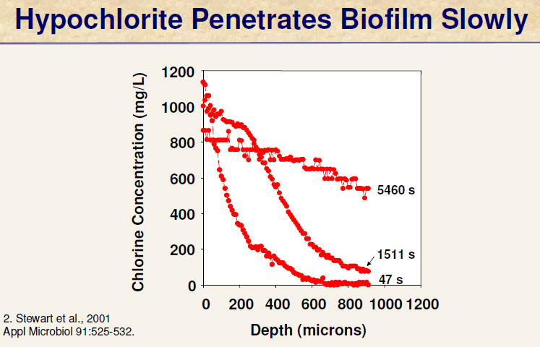
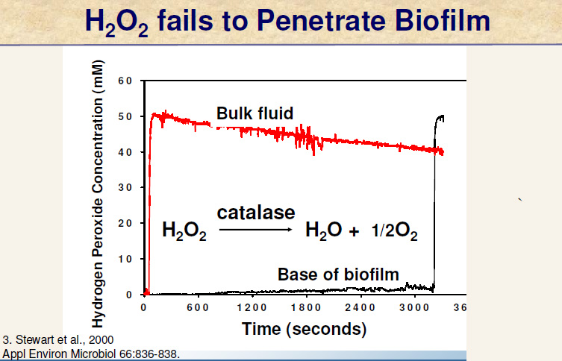
Disinfectants and Biofilm

Slide 25
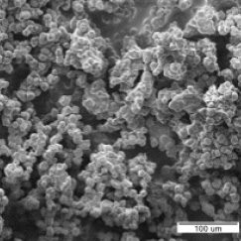
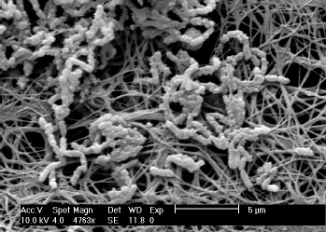
Biofilm in Water Systems And Medical Devices
Ryder, M. Medical Biofilm Research
TargetBSI.com Webinar 7/28/09
Donlan, RM. Biofilm Laboratory. CDC

Slide 26
Water Treatment System--Rhetoric
Once monthly disinfection adequate for all water treatment systems
No detectable bacteria and/or acceptable levels of endotoxin = No Biofilm
Turbulent flow in the loop prevents any biofilm formation
Filters only need to be changed at manufacturer recommended intervals

Slide 27
Water Treatment System--Reality
Water Quality is clinically relevant and a patient safety issue
Consolidation has increased BioMed Tech responsibilities
  Increased number of clinics to service
  Mix of system designs to maintain
  Older water treatment systems not being replaced due to cost constraints
    Technology can be the same as 25 years ago
    Larger diameter piping, long distance loops, storage tanks and system shut down times increase risk of biofilm formation
    Additional effort is needed to keep systems operational and in compliance with regulatory requirements
Less training time & budgets available

Slide 28
Water Treatment System--Reality
Regulations and documentation requirements are increasing
  Old Medicare Regs = 4 TAGS related to water and dialysate
  2008 CFC = 64 TAGS related to water
Top deficiencies related to water—
# | TAG # | TAG Description | # Cited | % of Surveys
11 | V196 | Carbon adsorption—Monitoring, testing, frequency | 96 | 10.1%
39 | V187 | Environment—Schematic diagrams/labels | 55 | 5.8%
49 | V260 | Personnel—Training program/periodic audits | 45 | 4.7%
53 |  | Softeners—Testing hardness/log | 41 | 4.3 %
Source: Glenda M Payne, ESRD Technical Advisor, Centers for Medicare & Medicaid Services, Dallas & Atlanta Regions
Surveys completed: 948 of 5477 providers

Slide 29
Water Treatment System--Future
Greater efficiency, lower Operating Costs
Distribution loop velocity readouts
RO membranes with higher rejection rates, lower operating pressures
Electrodeionization
Old systems replaced with new designs with lower operating costs
New piping materials—less bacterial adhesion, tolerance to more aggressive disinfection (e.g. ozone or heat)
Comprehensive automated daily sanitization/disinfection

Slide 30
Water Treatment System--Future
Greater efficiency, lower Operating Costs
More stringent bacterial and endotoxin level requirements
In-line monitoring systems to detect biofilm and bacterial/endotoxin levels
Better methods of removing biofilm
Ultrapure dialysate requiring ultrapure water
Validated process and process controlled systems

Slide 31
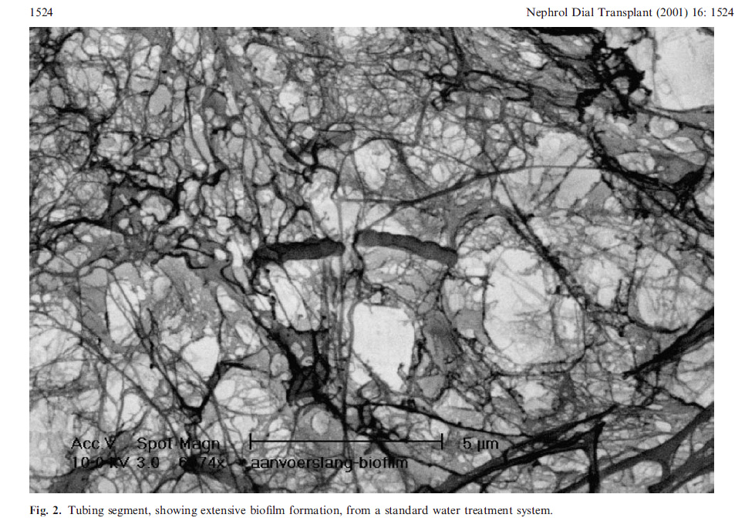
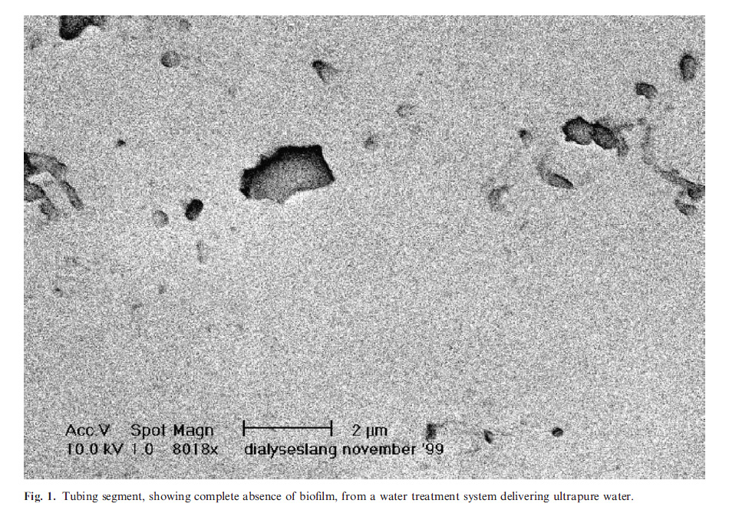
The Goal
Standard Dialysis Quality Water
Ultrapure Water

Slide 32
Concentrates & Dialysate--Rhetoric
It is OK to mix old and new batches of bicarbonate concentrate
Biofilm doesn’t form in bicarbonate concentrate
Containers don’t need to be disinfected once emptied of bicarbonate concentrate
Water quality doesn’t matter for Acid Concentrate
Dialysate contaminants don’t cross dialyzer membranes

Slide 33
Concentrates & Dialysate--Reality
Old Medicare Regs = 4 TAGS related to water & dialysate
2008 CFC = 28 TAGS related to dialysate
Bicarbonate concentrate can form biofilm on the inside of containers
  Disinfect with high level disinfectant/sterilant frequently and dry completely
Mixing old and new batches of bicarbonate concentrate can result in changes in pH and concentration
Acid concentrate if prepared with water containing large numbers of bacteria can result in endotoxin contamination
Dialysate contaminants bacterial debris and endotoxin can cross dialyzer membranes by diffusive backfiltration

Slide 34
Concentrates & Dialysate Reality—CFC Citations
TAG # | TAG Description | # Cited | % of Surveys
V250 | Dialysate proportioning—monitor pH/conductivity | 87 | 9.2%
V175 | Water & Dialysate Quality | 32 | 3.4%
Source: Glenda M Payne, ESRD Technical Advisor, Centers for Medicare & Medicaid Services, Dallas & Atlanta Regions
Surveys completed: 948 of 5477 providers

Slide 35
Concentrates & Dialysate--Future
On-line generation of bicarbonate concentrate
More stringent bacterial and endotoxin limits
Increased use of ultrafilters to meet more stringent requirements
Ultrapure dialysate production at point of use or via central delivery systems

Slide 36
Dialysis Machines--Rhetoric
The dialyzer prevents transmission of bacteria and endotoxin to patient so water and dialysate levels are irrelevant
Post disinfection sampling tells me the machine meets AAMI acceptable levels
As long as my monthly monitoring results are OK on a % of the dialysis machines, all of them are within limits and I don’t need to be concerned or have to trend my data

Slide 37
Dialysis Machines--Future
AAMI Standards likely to move closer to European (ISO) Standards—lower bacterial and endotoxin limits
Validation and process control required
On-line convective therapies may increase—Ultrapure dialysate, sterile substitution fluid
Increased use of in-line ultrafilters for ultrapure dialysate as standard of care

Slide 38
Dialysis Machines--Reality
Both low & high flux dialyzers can allow transfer of bacteria & endotoxin from dialysate to patient by backfiltration
Pre-disinfection sampling of a % of the dialysis machines/month gives a snapshot, it doesn’t tell you what is happening in all machines all of the time
Post disinfection sampling only tells you whether the disinfection procedure is effective or not

Slide 39
Bright Future for BioMed Techs
You can make a difference!
Employment expected to grow 27% over the next 9 years
Faster growth than the average for all occupations
The aging population puts more people at risk for developing ESRD
  Growth of this segment of the population is expected to be faster than that of the total population
Dialysis patient population is expected to increase (doubled in the UK over past 10 years)

Slide 40
The Bottom line
Patient Safety and Delivery of Quality Therapy is--

Slide 41

BIO MED TECHS ROCK!
You Can Make a Difference

Slide 42
Panel of Pioneers:
Perspective and
Predictions
Speakers:
V. Taaffe, J. Maltais, G. Rovegno, R. Ward
Notes:
>>SPEAKER INTERVAL SLIDE<<
>>NEXT<<

Slide 43
Perspective and Predictions:
EMRs
George Rovegno
MIQS Software

Slide 44
Perspective
EMRs can improve quality, reduce costs
EMRs make the necessary information readily available to the caregiver at the point of care
EMRs manage workflow and prevent things from falling through the cracks
EMRs are cheap and not much used

Slide 45
Predictions
Lack of skilled personnel will force IT solutions into healthcare. Substitute IT for people
Accountability
Quantification

Slide 46
The roles of EMRs
Care implications
  IT = Individualize Treatment
  Managing huge volumes of data at the point of care - Amount of data - Reporting of data
  Using the data
  Quality of care–team approach–efficient delivery
  Integral quality tools
Financial implications
  Quality rewards & penalties
  Financial survival

Slide 47
Individualize Treatment
The CfCs require individualized care and the surveyors are enforcing this rule.
  Regular (annual/monthly) assessments drive comprehensive care plans with mandatory follow-up and revision – teams of caregivers
  Assessment & PoC must be data driven – this requires computers and relational databases.

Slide 48
Large amounts of data require EMRs

Slide 49
Quality of Care
Outcomes & Quality –evidence based medicine requires lab values
  Whatever happened to CQI?
  Outcomes vs. Process
  Ratings and scores – like dialysis compare – public disclosure, more items
Accountability - tech credentialing

Slide 50
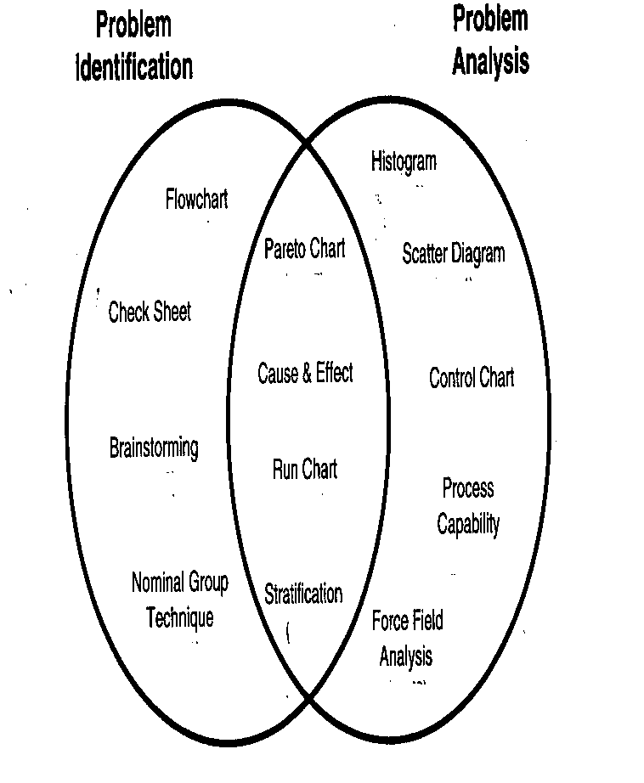
Process (CQI)

Slide 51
Documentation
Pay for what you document not just what you do
Time stamps, sign offs, P & Ps
If you document it correctly you avoid trouble and are paid correctly the first time.
  "Our professional staff has determined that the services were medically necessary and properly documented."

Slide 52
Physician MCP: Some Early Results
Billing data on 243 patients treated by HD in a single Dialysis Unit in March 2004* (In Feb 2004 <70% of possible was documented)
 | Recorded (#) | Maximum (#) | Percent of possible
Comprehensive encounter | 232 | 243 | 95.5%
Brief encounter | 709 | 729 | 97.3%
Billed G0317 (1 Comp & 3 Brief encounters) | 231 | 243 | 95.1%
Billed G0318 (1 Comp & 1-2 Brief encounters) | 10 | 243 | 4.1%
• Used wireless laptop computer on rounds
• Major effort made to utilize the software to record encounters
• Major administrative feedback to ensure physician compliance

Slide 53
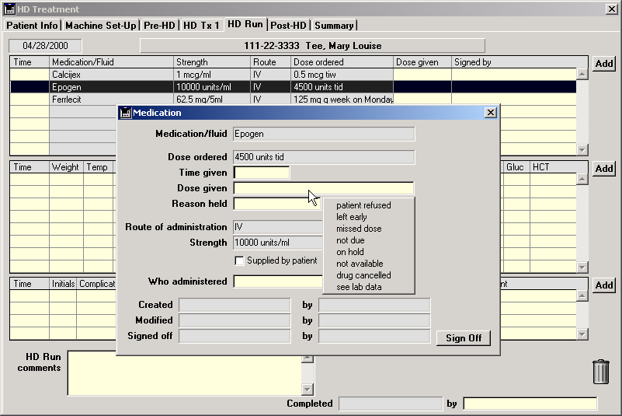
MIQS: Giving EPO During HD Run
An EPO Order on the HD Run Screen must be addressed.
Nurse documents administration or NON administration and signs off

Slide 54
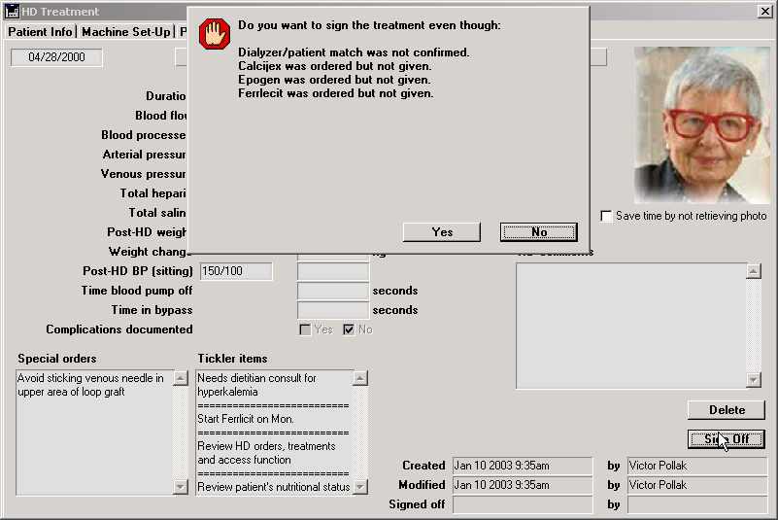
MIQS: Checking EPO at HD Sign off
Nurse Signs off at End of HD Treatment
A warning appears if the ordered EPO was not recorded as given-management tool

Slide 55
Bundling CPMs
ESRD QIP – reporting & quantification
9 Topic areas for 26 measures:
  Anemia, Dialysis Adequacy (Hemodialysis and Peritoneal Dialysis), Vascular Access, Mineral Metabolism, Influenza Vaccination, Mortality, and Patient Education, Satisfaction, and Quality of Life.
Will determine payments & penalties

Slide 56
HCIT
Healthcare is a major anomaly among information-intensive businesses - over $2T revenue business spending under 2% of revenue on IT. Not on EMRs
least exploited is the core of the business, clinical operations and clinical data.
cottage-industry nature, resistance of providers to be measured on their performance

Slide 57
The Future
More IT use
Increasing scrutiny
ESRD is a model for all healthcare
Quantification of quality
Global bundling
Lower payments for more work

Slide 58
Panel of Pioneers:
Perspective and
Predictions
Speakers:
V. Taaffe, J. Maltais, G. Rovegno, R. Ward
Notes:
>>SPEAKER INTERVAL SLIDE<<
>>NEXT<<

Slide 59

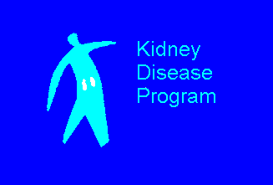
CHLORAMINE REMOVAL:
Is carbon always the answer?
Richard A. Ward

Slide 60
FREQUENT CHLORAMINE BREAKTHROUGH
Several dialysis units in the same geographical area obtain water from municipalities that draw their water supply from lakes.
Units use exchangeable carbon tanks with an EBCT ≥ 10 minutes.
Chloramine breakthrough occurs within a week of exchanging tanks.
What’s going on and what can be done to control chloramine levels without needing to constantly be changing carbon tanks?

Slide 61
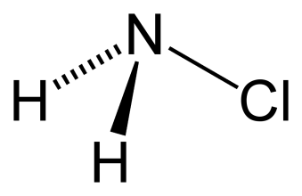
USE OF CHLORAMINE TO DISINFECT WATER SUPPLIES
Chloramines are formed by adding ammonia to chlorinated water.
  HOCl + NH₃ → NH₂Cl + H₂O (monochloramine)
  HOCl + NH₂Cl → NHCl₂ + H₂O (dichloramine)
  HOCl + NH₂Cl₂ → NCl₃ + H₂O (trichloramine)
The form of chloramine is pH dependent. At pH > 7, monochloramine is the most prevalent form.
MW = 51.5 Da

Slide 62
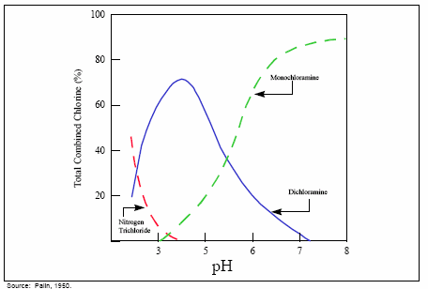
THE FORM OF CHLORAMINE DEPENDS ON pH

Slide 63
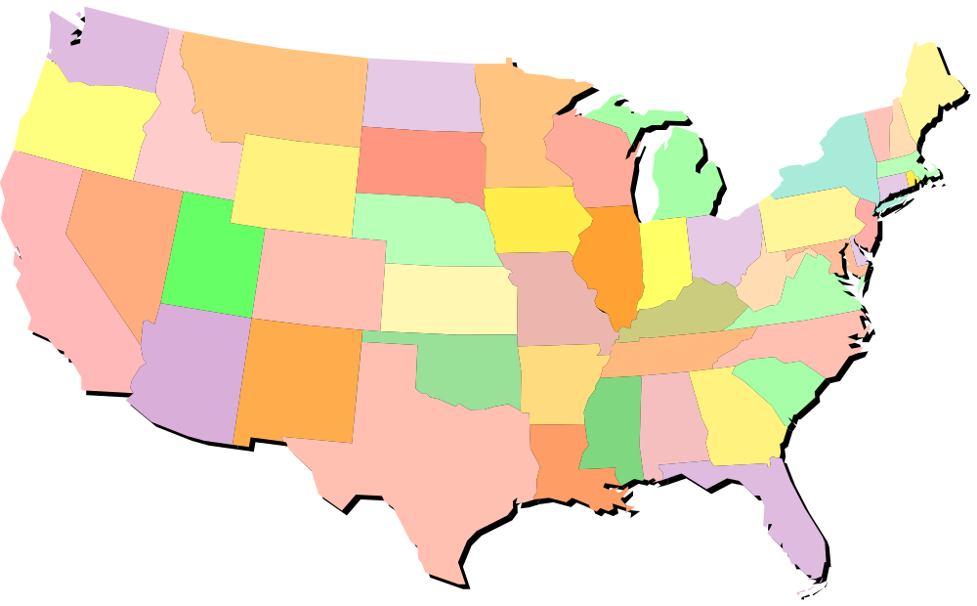
CHLORAMINE CONTENT OF TAP WATER
Added to water as an alternative disinfectant to chlorine to reduce the formation of carcinogenic trihalomethanes
Seattle 0
Portland 0-1.9
Grand Forks 1.8-3.3
Boise 0
Madison 0
Denver 1.1-2.0
Philadelphia 1.4-2.9
Topeka 2.7-3.20
Louisville 1.0-3.5
San Diego 1.9-2.4
Albuquerque 0
Savannah 0
New Orleans 0.3-4.7
McAllen 0.5-3.6

Slide 64
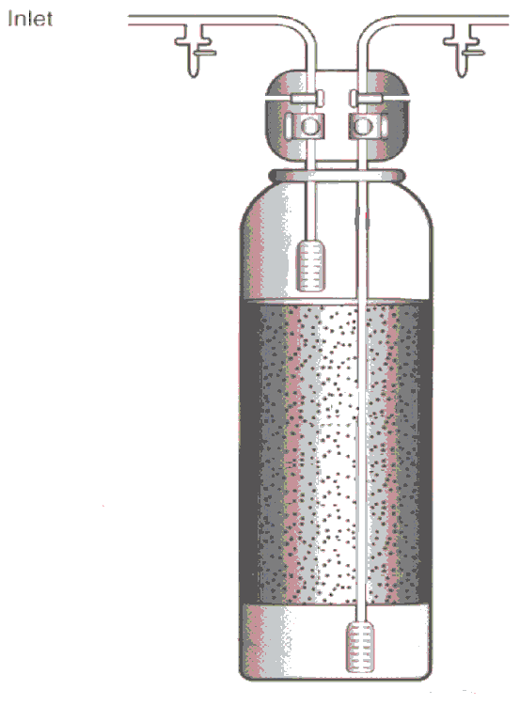
REMOVAL OF CHLORAMINE
Carbon adsorption with granular activated carbon is generally the most effective means of removing chloramines.
Two beds are connected in series to give a total EBCT of ≥ 10 minutes.
Testing for chloramine between the beds is used to prevent disruptions in operation following unanticipated breakthrough.
Image courtesy of FMS

Slide 65
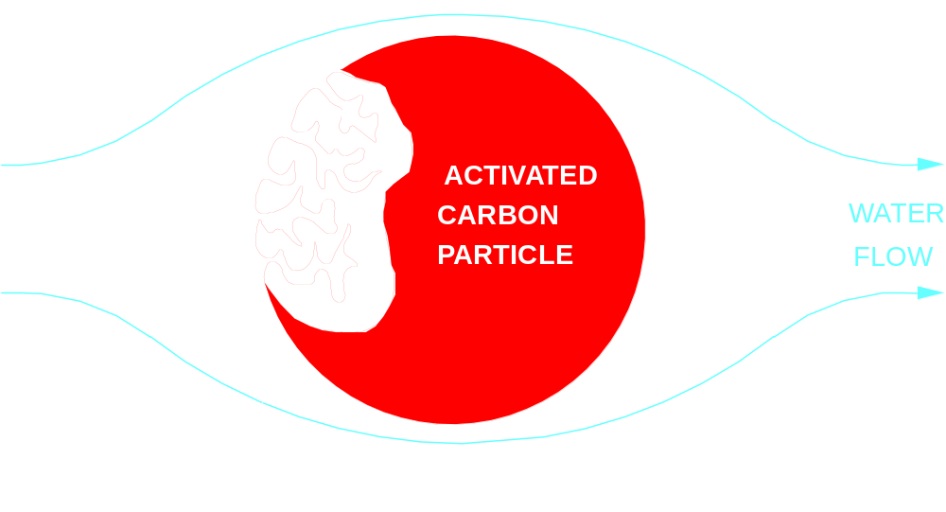
REMOVAL OF CHLORAMINE BY CARBON

Slide 66
CARBON REMOVES CHLORAMINE VIA AN OXIDATION REACTION
Two reactions take place at the carbon surface:
  C* + NH₂Cl + H₂O → NH₃ + H⁺ + Cl⁻ + CO*
  CO* + 2NH₂Cl → N₂ + H₂O + 2H⁺ + 2Cl⁻ + C*
The reaction rate for monochloramine oxidation of carbon is much slower than the rate for oxidation by hypochlorous acid/hypochlorite ion.
Catalytic carbon is carbon that has been modified to have more surface reaction sites

Slide 67
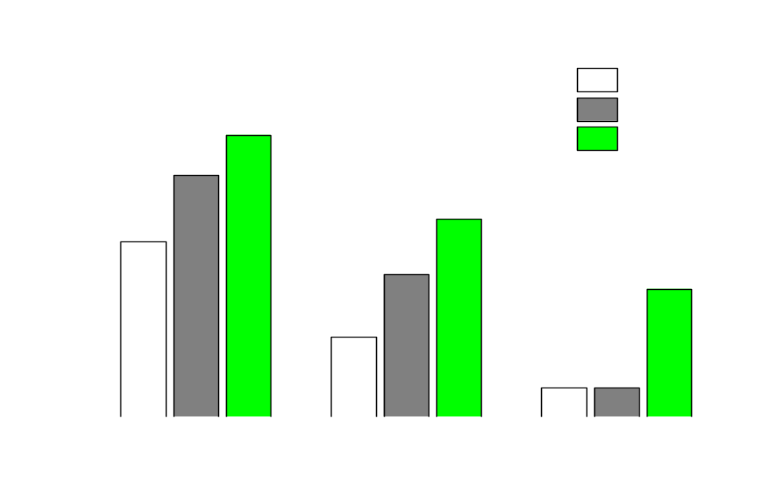
EFFECT OF pH ON CHLORAMINE REMOVAL
Fairey JL, et al. J AWWA 99:110-120, 2007

Slide 68
EFFECT OF NATURAL ORGANIC MATERIAL ON CHLORAMINE REMOVAL
Adapted from: Fairey JL, et al. Environ Sci Technol 40:4268-4273, 2006

Slide 69
WHAT CAN REDUCE THE EFFECTIVENESS OF CHLORAMINE REMOVAL BY CARBON?
Substances that prevent monochloramine from reaching the reactive sites on the carbon surface.
  Corrosion inhibitors, such as orthophosphate.
  Organic material in the water.
Conditions that slow the rate of reaction.
  Low temperature.
  High pH.

Slide 70
WHAT ARE THE OPTIONS WHEN CARBON PROVIDES INADEQUATE CHLORAMINE REMOVAL?
Remove substances that mask reactive sites.
Adjust the temperature and pH for optimal carbon performance
Use alternative methods of removal

Slide 71
ALTERNATIVES AND SUPPLEMENTS TO CARBON ADSORPTION
ANION EXCHANGE RESINS (ORGANIC SCAVENGER)
  Remove organic matter and other substances that may foul carbon.
CHEMICAL INJECTION SYSTEMS
  pH adjustment for optimal carbon adsorption.
  Sodium bisulphite reduces chlorine species to chloride.
REDOX ALLOY MEDIA (KDF RESIN)
  Copper/zinc alloys that reduce chlorine species to chloride.
  Limited pH range.
  Not effective with orthophosphate and polyphosphate.
ULTRAVIOLET IRRADIATION
  Converts chlorine species to chloride (254 nm).
  Breaks down organic species (185 nm).

Slide 72

ALTERNATIVES AND SUPPLEMENTS TO CARBON ADSORPTION
ANION EXCHANGE RESINS (ORGANIC SCAVENGER)
  Remove organic matter and other substances that may foul carbon.
CHEMICAL INJECTION SYSTEMS
  pH adjustment for optimal carbon adsorption.
  Sodium bisulphite reduces chlorine species to chloride.
REDOX ALLOY MEDIA (KDF RESIN)
  Copper/zinc alloys that reduce chlorine species to chloride.
  Limited pH range.
  Not effective with orthophosphate and polyphosphate.
ULTRAVIOLET IRRADIATION
  Converts chlorine species to chloride (254 nm).
  Breaks down organic species (185 nm).

Slide 73
INJECTION SYSTEMS
CONTROL THE RATE OF INJECTION
  Acid injection can be controlled by pH
  Bisulfite injection can be controlled by oxidation- reduction potential (ORP)
FOR ACID INJECTION
  Use a mineral acid
  Select a target pH consistent with proper operation of other purification processes

Slide 74
EFFECT OF pH ON FLUORIDE REMOVAL
DATE | pH | FLUORIDE (mg/L) |  |  | RO REJECTION (%)
 |  | FEED | POST-HCl | PRODUCT
JAN 02 | 10 | 0.79 |  | 0.005 | 99
HCl INJECTOR INSTALLED IN PRE-TREATMENT
MAR 02 | 7 | 0.79 | 0.77 | 0.011 | 99
APR 02 |  | 0.76 | 0.76 | 0.015 | 98
JUL 02 |  | 0.81 |  | 0.005 | 99
OCT 02 |  | 0.86 | 0.81 | 0.073 | 91
JAN 02 | 6 | 0.85 | 0.88 | 0.884 | 0
NEW RO MEMBRANES INSTALLED
FEB 02 | 6 | 0.81 | 0.81 | 0.158 | 80
FEB 02 | 10 | 0.90 | 0.85 | 0.005 | 96
MAR 02 | 8 | 0.86 | 0.87 | < 0.01 | 99

Slide 75
EFFECT OF pH ON ALUMINUM IN WATER
Parkinson IS et al. J Clin Pathol 34:1285-1294, 1981

Slide 76
TESTING FOR TOTAL CHLORINE
N-chloramines (organic chloramines) will test positive in DPD-based assays.
Other oxidizing agents (e.g., permanganate) will test positive in DPD- and MTK-based assays.
Manganese oxides interfere with DPD-based assays, but not MTK-based assays
  N-chloramines and permanganate are rejected by reverse osmosis.
  If you suspect interference in the DPD assay, measure total chlorine after the RO.

Slide 77
CHLORAMINE REMOVAL
Levels in municipal water are a moving target.
Establish communications with your water provider.
Other changes in municipal water may impact on the ability of carbon to remove chloramine.
When installing an alternative means for chloramine removal, think how it will impact the rest of the treatment system.
If there is unexpected breakthrough, think about possible interferences with the chloramine assay.

Slide 78
Panel of Pioneers:
Perspective and
Predictions
Speakers:
V. Taaffe, J. Maltais, G. Rovegno, R. Ward
Notes:
>>SPEAKER INTERVAL SLIDE<<
>>END<<

